Slide 1
Chapter 13
Conservation
of energy

Slide 2
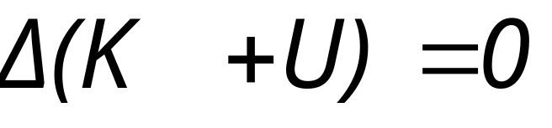
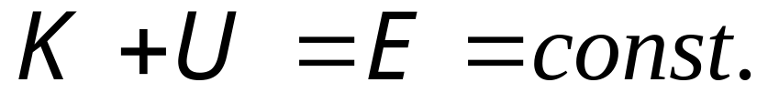
No work done on a system by external forces
System K, U

Slide 3
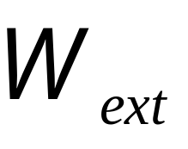
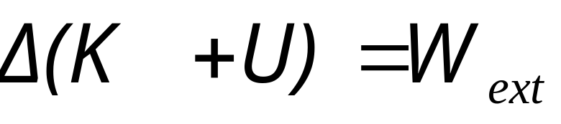
Work done on a system by external forces
System?
System K, U

Slide 4
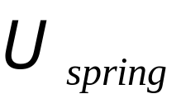
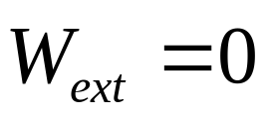

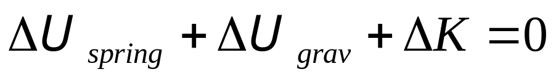
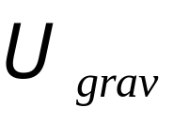

Slide 5
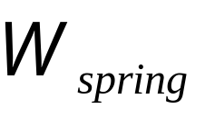
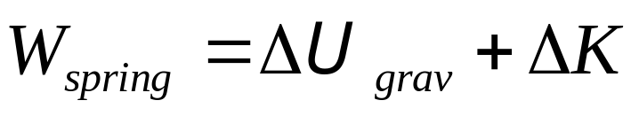

Slide 6
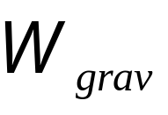
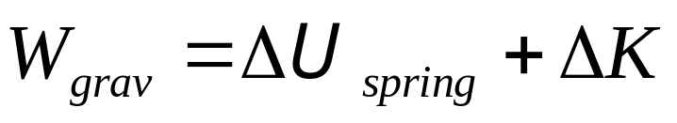

Slide 7
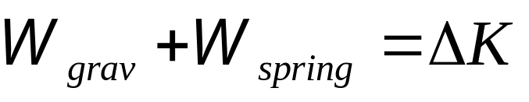

Slide 8
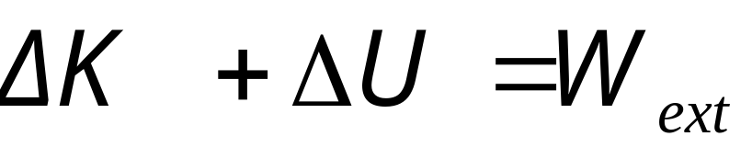
Work done on a system by external forces
System K, U
Mechanical Energy

Slide 9
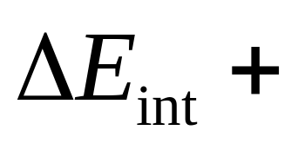
Work done on a system by frictional forces
System K, U
Mechanical Energy

Slide 10
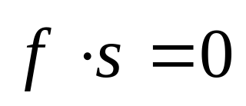
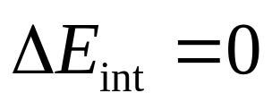
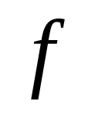
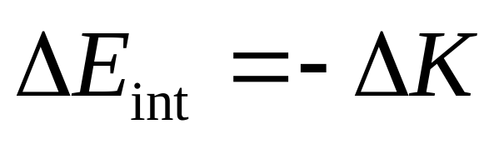
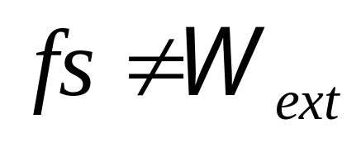
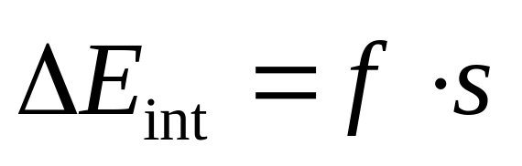
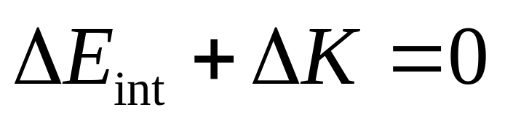
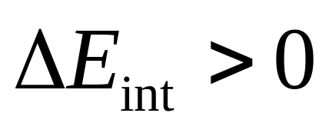
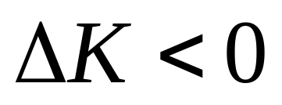
Rotation without slipping
?

Slide 11
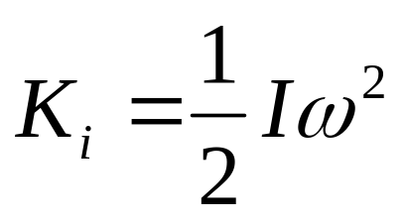
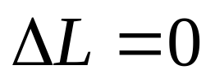
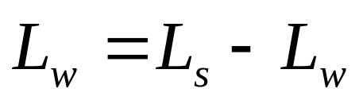
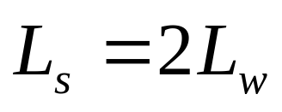
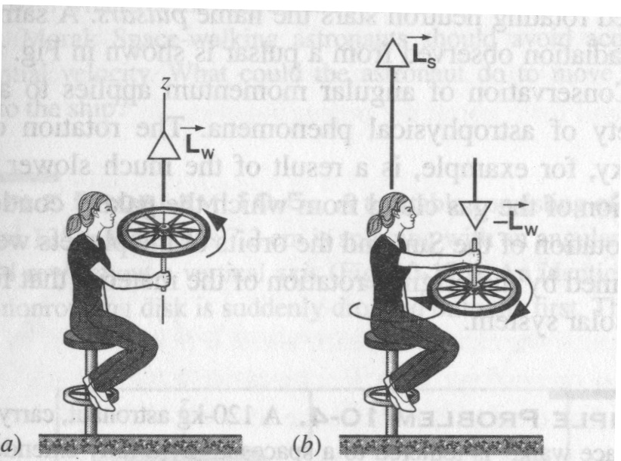
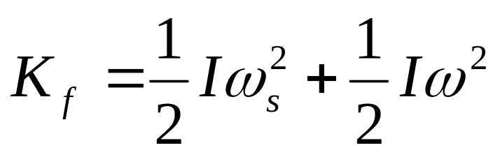
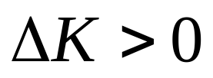
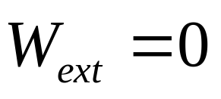
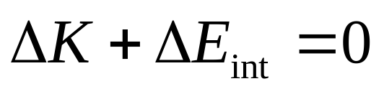
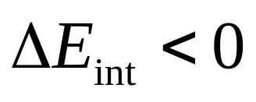

Slide 12

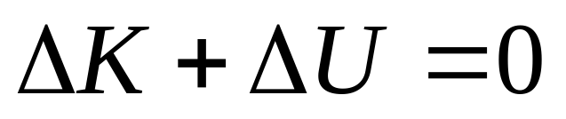
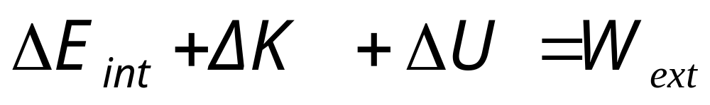
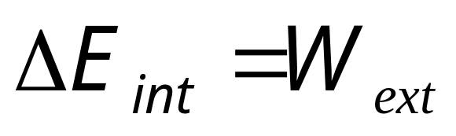
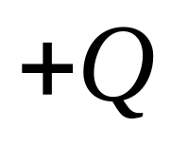
Work done on a system by frictional forces
System K, U
Mechanical Energy
The first law of thermodynamics

Slide 13
A block with mass m and initial speed v, its speed graduall decreases to zero when it travel a distance d
Example:
v
d
30°
Find (1) ΔE_{int}, does the system of block + table+Earth due to friction. (2) If the block slide from the rest back down the table, find the speed when the block passes through the initial point.

Slide 14
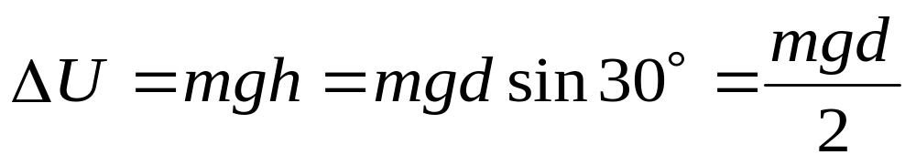
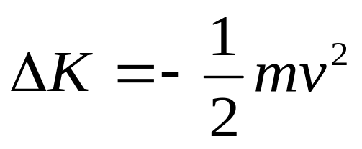
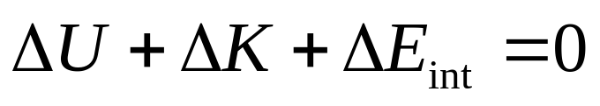
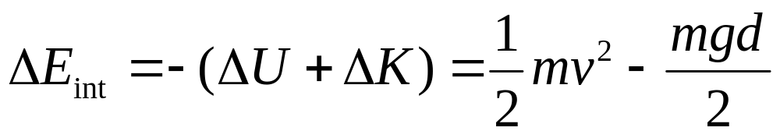
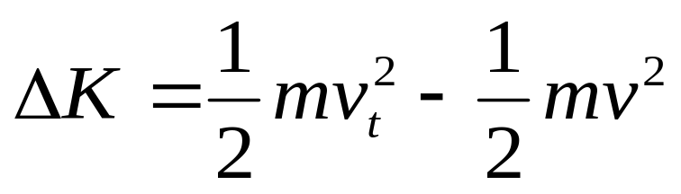

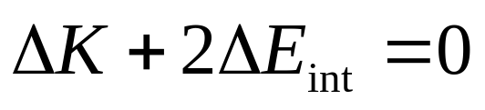
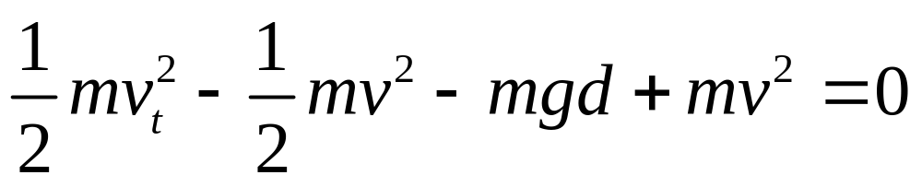
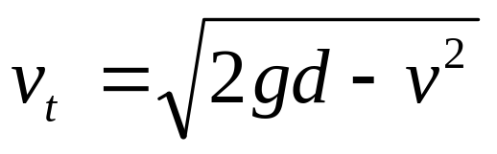
Example:
v
d
30°

Slide 15
ω₀
Example

Slide 16

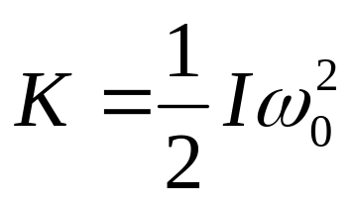
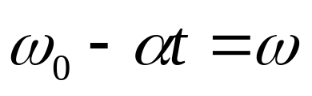
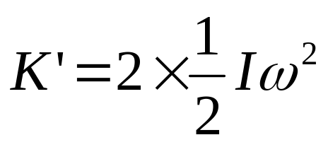
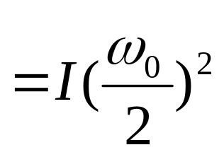






ω ω
Example

Slide 17




ω ω
Example

Slide 18











Center-of-mass energy
The center-of-mass energy equation (COM)

Slide 19


Reaction and Decays
Reaction A+B→C+D
Decays A→B+C

Slide 20




Mechanical Energy
A
C
D
B
Potential energy U_{i}=U_{f} =0
Kinetic energy K_{i}→K_{f}
Internal energy E_{int,i}→E_{int,f}

Slide 21











Example In the alpha-decay

Slide 22





Review

Slide 23




















Rolling without slipping

Slide 24
m, L
m, v

Slide 25
m, L
m, v

Slide 26
m, L

Slide 27












During collision
After collision

Slide 28
m, L
m, v_{o}

Slide 29
m, L
m, v_{o}

Slide 30






During collision
m, L
v
After collision

Slide 31
m, L
m, v₀

Slide 32
m, L
m, v₀

Slide 33














Elastic collision
v
After collision

Slide 34
m, L
m, v₀

Slide 35
m, L
m, v₀

Slide 36







During collision
Elastic collision
m, L
m, v₀

Slide 37




During collision
inelastic collision
m, L
m, v₀
After collision

Slide 38
CHAP.13
Exercises 14, 15 (P296)
Problems 1, 2, 5 (P297)

